Slide 1
Maze Router
Presented By: Dalia El-Naggar 900191234
Nada Atia 900193555

Slide 2
Introduction
Cell Synthesis Steps
Routing Problem

Slide 3
Lee’s Algorithm
Step 1: Filling
Step 2: Back-propagation

Slide 4
Implementation Aspects
Via usage and wrong direction penalties
Multiple pins per net
Avoiding pins from other nets.

Slide 5
Implementation Aspects (cont.)
Back-propagation implementation issues
Re-ordering Heuristic
Results Visualization

Slide 6
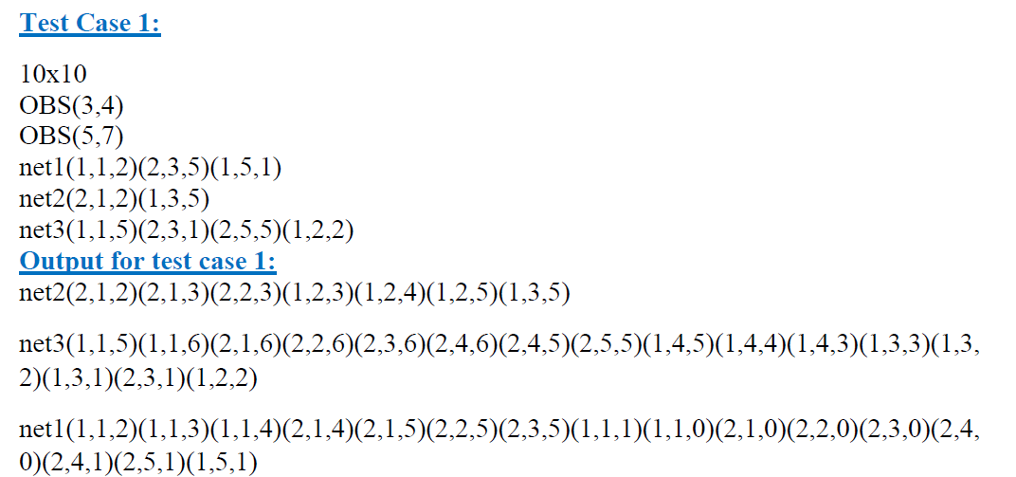
Sample Test Case 1

Slide 7
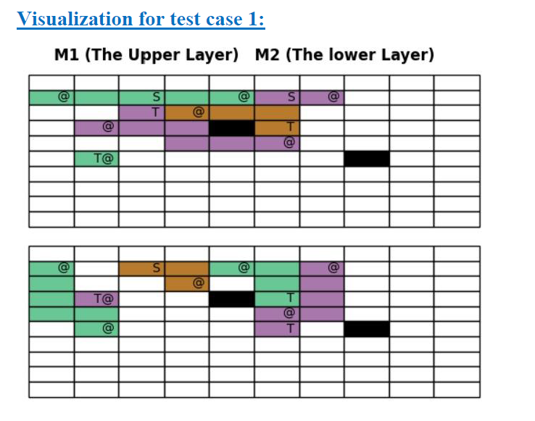
Sample Test Case 1

Slide 8
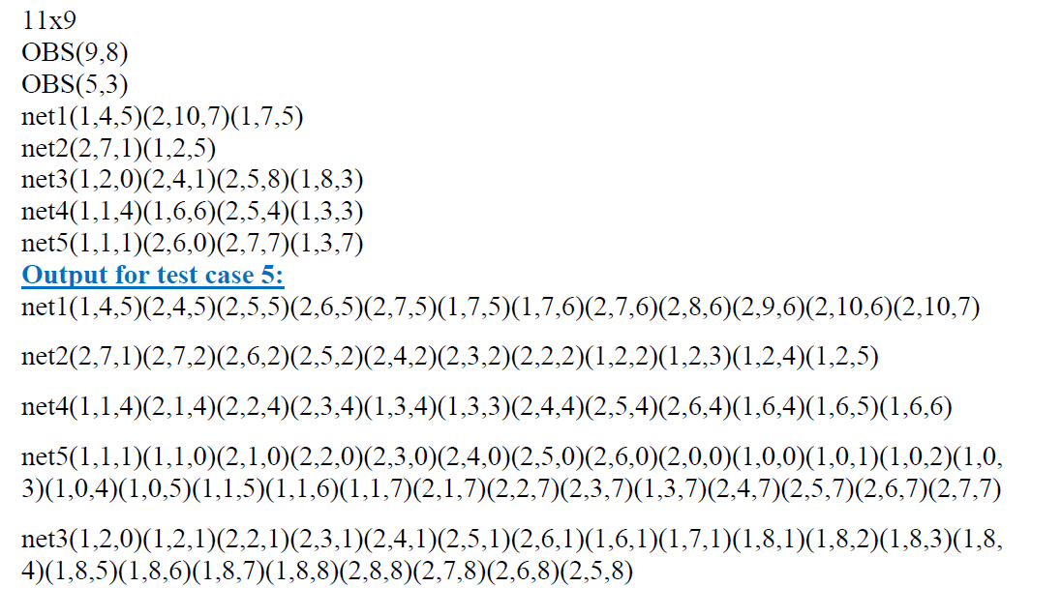
Sample Test Case 2

Slide 9
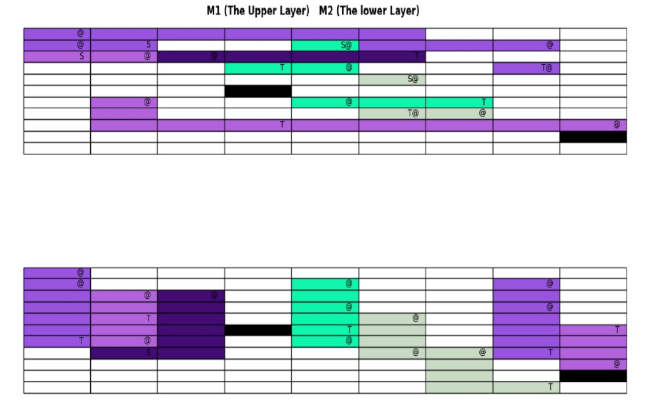
Sample Test Case 2

Slide 10
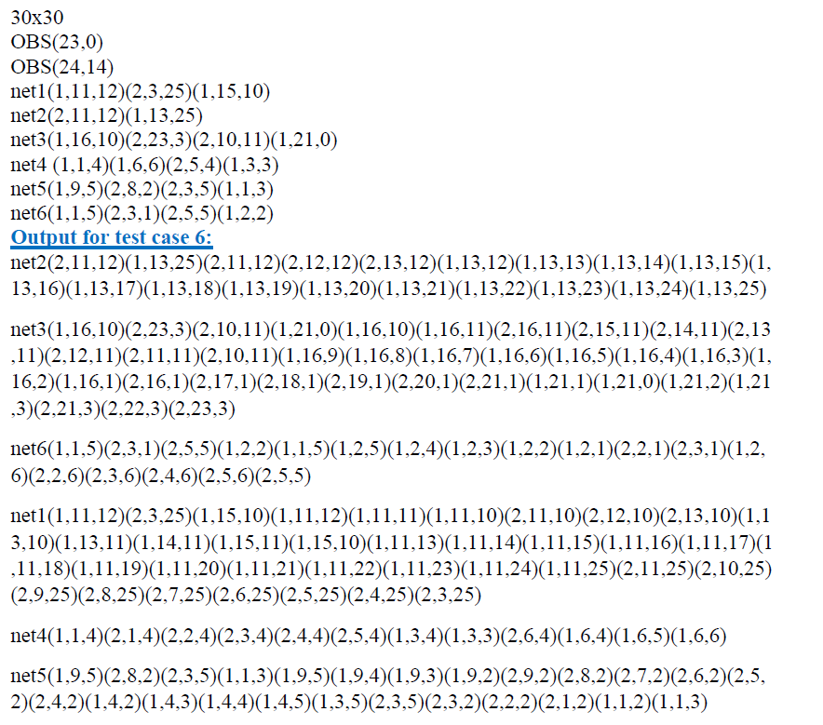
Sample Test Case 3

Slide 11
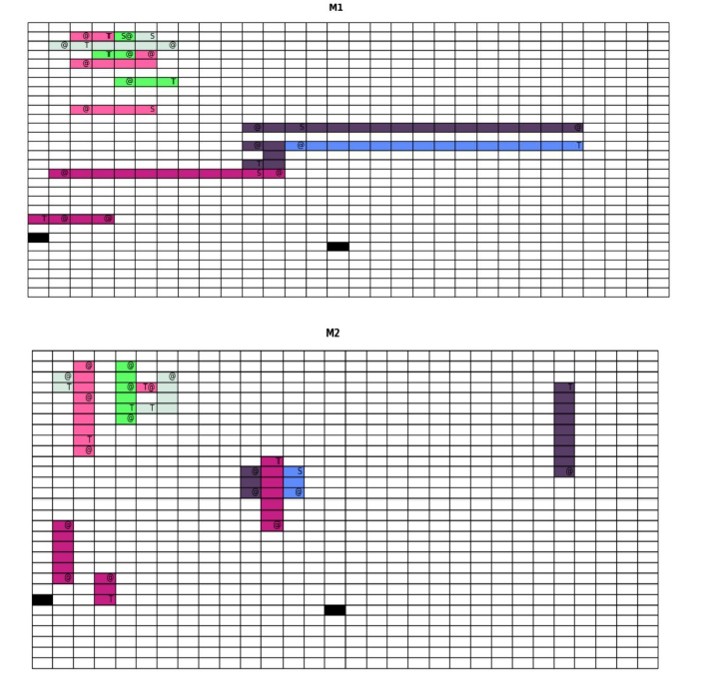
Sample Test Case 3

Slide 12
Limitations
The program works on only two metal layers
Time and Space Complexity
Issues visualizing layers with large dimensions

Slide 13
Conclusions

Slide 14
Thank you!

